Slide 1

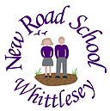


Aspire Learning Trust
SEND Information Report
September 2025

Slide 2
Executive Head Teacher – Mr Robert Litten
Executive Deputy Head Teacher – Mrs Rachel Bains
Primary SENDCo – Mrs Frances Light-Rudland
Executive Head Teacher – Mr Robert Litten
Executive Deputy Head Teacher – Mrs Rachel Bains
Primary SENDCo – Mrs Frances Light-Rudland
Principal– Ms Dawn White
Deputy Principal – Ms Anna Wahlandt
SENDCo – Mrs Laura Lancaster
Primary SENDCo and SEND Transition Lead – Mrs Frances Light-Rudland
Aspire Learning Trust
CEO - Dr Matthew Laban

Slide 3
Primary Senior SENDCo – Mrs Frances Light-Rudland (Overseeing all SEND Provision)
Nursery, Reception & Year 1 SENDCo – Mrs Shelly Ruggles
Years 2, 3 and 4 – Assistant SENDCo – Mrs Jodie Jarvis
Years 5 & 6 SENDCo – Mrs Frances Light-Rudland
Primary Senior SENDCo – Mrs Frances Light-Rudland (Overseeing all SEND Provision)
Nursery and Lower School (Nursery, Reception, Year 1, 2, W1) SENDCo – Miss Louise Tansley
Upper School (W2, Year 4 and 5) SENDCo – Miss Charlotte Jones
Year 6 SENDCo – Mrs Frances Light-Rudland
SENDCO – Mrs Laura Lancaster
Primary Senior SENDCo and SEND Transition Lead – Mrs Frances Light-Rudland (Supporting 2 days a week)
Deputy SENDCo – Miss Georgia Purdy
The SENDCo Team

Slide 4
Note on terminology: Aspire Learning Trust provides education at all ages and stages. For this reason, the term Children Young Person (CYP) will be used throughout this policy in reference to children, pupils and students.
What is SEND?
SEND Code of Practice 2014: (updated January 2015)
What is a special educational need or disability?
CYP have special educational needs if they:
have a learning difficulty that calls for additional and different provision to be made for them
have a significantly greater difficulty in learning than the majority of CYP of the same age
have a disability that prevents or hinders them from making use of educational facilities of a kind generally provided for CYP of the same age
are under compulsory school age and fall within the definitions above or would do if special educational provision was not made for them
(2014 Code of Practice)
What type of special educational needs can Aspire Learning Trust support?
CYP who have communication and interaction needs eg Autistic Spectrum Disorder, speech and language need requiring input from Speech Therapist
CYP who have cognition and learning needs eg they work at a much lower level than most CYP of their age
CYP who have specific learning difficulties eg they are visually impaired, hearing impaired
CYP who have physical and sensory needs eg they use a wheelchair or have a catheter or are diabetic
CYP who have behavioural, emotional and social development needs eg ADHD

Slide 5
Communication and Interaction:
CYP with speech, language and communication needs (SLCN) who have difficulty communicating with others. This may be because they have difficulty saying what they want to, understanding what is being said to them or they do not understand or use social rules of communication. The profile for every child with SLCN is different and their needs may change over time. They may have difficulty with one, some or all of the different aspects of speech, language or social communication at different times of their lives. CYP with ASD, including Asperger's Syndrome and Autism, are likely to have particular difficulties with social interaction. They may also experience difficulties with language, communication and imagination, which can impact on how they relate to others.
What are the areas of SEND?
Communication and Interaction
Cognition and Learning
Social, Emotional and Mental Health
Physical and/or Sensory need
Cognition and Learning:
Support for learning difficulties may be required when CYP learn at a slower pace than their peers, even with appropriate differentiation. Learning difficulties cover a wide range of needs, including moderate learning difficulties (MLD), severe learning difficulties (SLD), where CYP are likely to need support in all areas of the curriculum and associated difficulties with mobility and communication, through to profound and multiple learning difficulties (PMLD), where CYP are likely to have severe and complex learning difficulties as well as a physical disability or sensory impairment. Specific learning difficulties (SpLD), affect one or more specific aspects of learning. This encompasses a range of conditions such as dyslexia, dyscalculia and dyspraxia.

Slide 6
Social, Emotional and Mental Health Difficulties:
CYP may experience a wide range of social and emotional difficulties which manifest themselves in many ways. These may include becoming withdrawn or isolated, as well as displaying challenging, disruptive or disturbing behaviour. These behaviours may reflect underlying mental health difficulties such as anxiety or depression, self-harming, substance misuse, eating disorders or physical symptoms that are medically unexplained. Other CYP may have disorders such as attention deficit disorder, attention deficit hyperactive disorder or attachment disorder. Schools and colleges should have clear processes to support CYP, including how they will manage the effect of any disruptive behaviour so it does not adversely affect other pupils. The Department for Education publishes guidance on managing students’ mental health and behaviour difficulties in schools.
What are the areas of SEND?
Communication and Interaction
Cognition and Learning
Social, Emotional and Mental Health
Physical and/or Sensory need cont.
Sensory and/or physical needs:
Some CYP require special educational provision because they have a disability which prevents or hinders them from making use of the educational facilities generally provided. These difficulties can be age related and may fluctuate over time. Many CYP with vision impairment (VI), hearing impairment (HI) or a multi-sensory impairment (MSI) will require specialist support and/or equipment to access their learning, or habitation support. CYP with an MSI have a combination of vision and hearing difficulties. Information on how to provide services for deafblind CYP is available through the Social Care for Deafblind Children and Adults guidance published by the Department of Health. Some CYP with a physical disability (PD) require additional ongoing support and equipment to access all the opportunities available to their peers.

Slide 7
In general, the following are NOT SEN, but may impact on progress and attainment:
Disability (responsibility on a school to provide ‘reasonable adjustments’), but this alone does not constitute SEN.
Attendance and punctuality.
Health and welfare.
English as an additional language (EAL).
Being in receipt of Pupil Premium (which includes Looked After Children and those of serviceman/woman).
Behavioural difficulties do not necessarily mean that a child or young person has a SEN and should not be automatically lead to a student being registered as having SEN.
Slow progress and low attainment do not necessarily mean that a child is SEN and should not automatically lead to a student being recorded as having SEN.
What is not SEND?
Areas that might affect progress and attainment

Slide 8
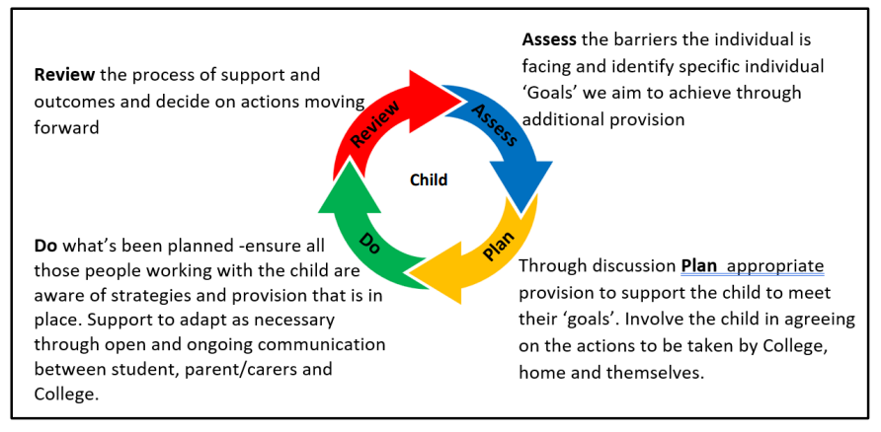
You, your child’s teacher, relevant support staff and the SENDCo will work closely together to:
assess your child’s needs
plan the support
carry out the support (do)
review the outcomes of the support
How do we support SEND?
Graduated Approach
Four wave approach
Pupils with SEND needs may have additional support plans in place to assist with their learning, including a very detailed support plan for those CYP with an EHCP. This ensures that support is consistent throughout the school and progress outside academic achievement, for example improved social skills, being able to work in a group, can also be monitored and success recognised.

Slide 9
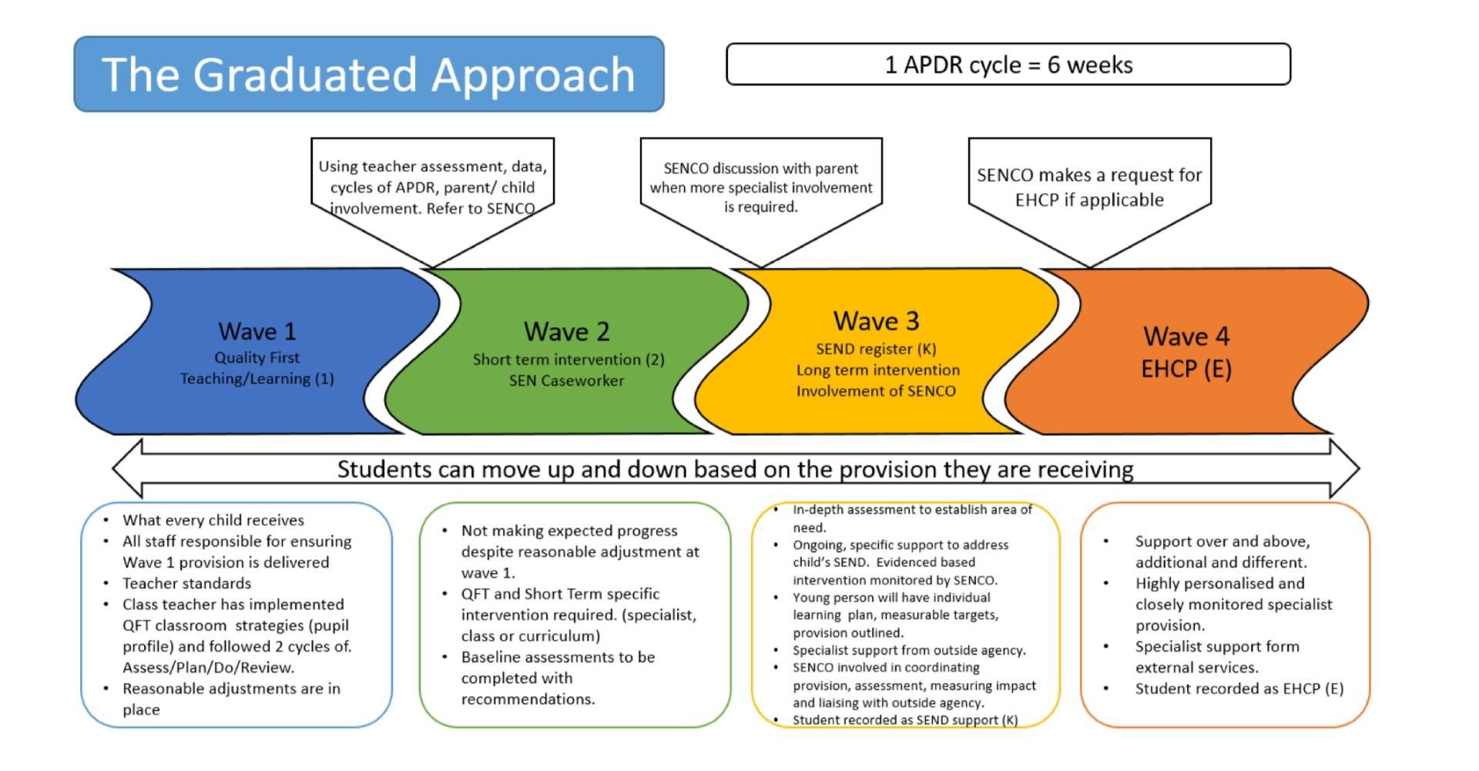

Slide 10
How do you identify a need?
Assessment and Identification
Click on the school icon to be taken to the relevant school

Slide 11
The special educational needs of most CYP is managed successfully by the support given at school. Sometimes, however, it is necessary to refer a child to outside agencies to receive more specialised expertise. This will only happen following several review cycles and will always be in consultation with you and your child.
Our school uses:
EP (Educational Psychologist)
Specialist Teachers and Practitioners
Access and Inclusion Managers from local authority
Consultant Paediatrician
Speech and Language Therapy
OT (Occupational therapy)
Physiotherapy
CAMHS (Child & Adolescent Mental Health Services)
Mental Health and Well-being service
Social care
School nurse
Family support worker
Locality Team
EWO (Education Welfare Officer who monitors attendance and supports families whose CYP are reluctant to attend school)
Professionals involved with SEND?
External professionals and medical professionals

Slide 12
Across the three schools there are Senior Mental Health Leads and Mental Health Champions. They are:
Mental Health and Well-being
Support and referral process
Rachel Bains
Deputy Head
Designated Senior Mental Health Lead
Frances Light-Rudland
Primary Senior SENDCo
Designated Senior Mental Health Lead
Lucy Porter
Class Teacher
Mental Health Champion
Frances Light-Rudland
Primary Senior SENDCo
Designated Senior Mental Health Lead
Stevie Thorton
Mental Health Student Lead
Frances Light-Rudland
Primary Senior SENDCo and SEND Transition Lead
Designated Senior Mental Health Lead
Irum Ihsan
Safeguarding Team
Mental Health Support
Referrals to the Mental Health and Well-being team can be completed by speaking to a member of the team at each school.

Slide 13
What training have staff had?
What can we offer?

Slide 14
Support Services for parents of students with SEN
Local Offer
The Local Offer is available as a link to your Local Authority website where you can see details of what is available in the area you live in for your child. It will include information about health and social care services, education, leisure activities and support groups in the area for CYP aged 0-25 with SEND and their families. It can be found at: www.cambridgeshire.gov.uk/SEND
The Department for Education’s SEN Code of Practice: https://www.gov.uk/government/publications/send-code-of-practice-0-to-25
SENDIASS (Special Educational Needs and disability Information and Advice Service)
https://www.cambridgeshire.gov.uk/residents/children-and-families/localoffer/local-offer-care-and-family-support/send-information-advice-and-supportservice-sendiass/
National Autistic Society
https://www.autism.org.uk/ or telephone: 0808 800 4104
Pinpoint ADHD and ASD support Groups:
https://www.pinpoint-cambs.org.uk or telephone 01480 877 333
What other support is out there?
Local offer
Support agencies

Slide 15
What is the transition like?
Nursery – Primary
Primary – Secondary
Secondary - Adulthood

Slide 16
The Accessibility plan is in accordance with the planning requirements in the Disability Discrimination Act 1995 and in accordance with the guidance issued by the DfE in 2002 in the document ‘Accessible Schools: Planning to increase access to schools for disabled students’.
The Key Objectives are:
To reduce or eliminate barriers to access to the curriculum.
To be able to fully participate in the school community for pupils, prospective pupils and any adult users with a disability.
What accessibility is there?
Click on the school icon to be taken to the relevant school

Slide 17
If any parents/carers have a complaint concerning the special educational provision for their child or about special educational provision generally, they should speak to the Teacher/Form Tutor, Phase Leader/Head of House and/or Phase/Deputy SENDCo initially.
If this proves unsuccessful the matter should be referred to the Executive SENDCo (Primary) and SENDCo (Secondary), but if you feel that this still hasn’t been successful then you can speak to the Executive Head teacher (Primary) and Principal (Secondary).
Should the matter still be unresolved the parents/carers should contact the Governor responsible for SEND. If the approach is to a Governor s/he will, in the first instance, refer it to the Executive Head teacher (Primary) and Principal (Secondary).
Your complaint will then be investigated and you will receive your initial response from the Chair within 10 days. If the matter still has not been resolved to the parent’s satisfaction they can request a review of the written information concerning their complaint by a panel of school Governors. They have 10 days to make this request.
What to do if you feel that support is not there or right for your child?
Complaints

Slide 18
New Road Primary and Nursery School
Primary
CEO – Dr Matthew Laban
Executive Head Teacher – Mr Robert Litten
Primary Senior SENDCo – Mrs Frances Light-Rudland
SENDCo Team
Nursery , Reception & Year 1 - Mrs Shelly Ruggles
Year 2, 3 & 4 - Mrs Jodie Jarvis
Years 5 & 6 – Mrs Frances Light-Rudland

Slide 19
How does the school know if a child needs extra help?
limited progress is being made
behaviour issues occur quite regularly
school staff mention their concerns to senior leadership staff
parents/carers are worried about their child
a health professional (eg GP, health visitor, speech therapist) has concerns about a child
information given to school by a previous school or nursery
a child asks for help
a child’s behaviour or progress changes
a child needs support that is different from and in addition to our usual practice
termly pupil progress meetings and mentoring meetings indicate that extra help is needed
How do you identify a need?
Assessment and Identification
How will the school let me know if they have any concerns about my child?
your child’s teacher will speak to you informally first and give you some ideas to try out at home
you will then be invited to meet school staff more formally to agree an action plan
you will also meet your Phase SENDCo and or Executive SENDCo

Slide 20
Training that the SENDCo team have had:
National Award for SEN Co-ordination
Briefings
Forums
Conferences
Training that the SENDCo team have provided training opportunities for all staff in relation to:
Social skills
Colourful semantics
Social Thinking model
Social communication
Sensory Circuits
Sensory processing
Autism Spectrum Trust courses – AET Level 1, 2 and 3
Dyslexia friendly classroom
Some staff have had specific training in areas which are:
ELSA – Mrs Sally Standbridge
What training have staff had?
What can we offer?

Slide 21
Nursery to Primary:
New Road Primary and Nursery School works in partnership with our local early years settings and onsite nursery to help CYP make the move from nursery to primary education as smooth as possible. We appreciate that this may be daunting for many CYP and therefore we encourage many events that ensure the CYP experience ‘big school’ before they actually arrive in September, for example:
Stay and play
Story time
Information/visit evenings - including a tour of the school
Tour of the school
Move up days
Some CYP, with specific SEND needs, may require a more enhanced transition support. This may be carried out by combining visits from New Road Primary staff to the nursery’s to work with students within their own known and familiar environment. This helps the CYP become familiar with the school environment and begin to build relationships with familiar adults.
What is the transition like?
Nursery – Primary

Slide 22
Primary to Secondary:
New Road Primary and Nursery School works in partnership with our local secondary schools to help CYP make the move from primary to secondary education as smooth as possible. We appreciate that this may be daunting for many CYP and therefore we encourage many events that ensure the CYP experience ‘big school’ before they actually arrive in September, for example:
Meet and greet on primary site with staff from secondary (Head of Year and SSD staff)
Transition afternoons
Information/visit evenings - including a tour of the school
Tour of the school
Move up days
Some CYP, with specific SEND needs, may require a more enhanced transition support. This may be carried out by combining visits from Sir Harry Smith Community College or other Secondary School staff to the primary school to work with students within their own known and familiar environment. This helps the CYP become familiar with the school environment and begin to build relationships with familiar adults.
What is the transition like?
Primary - Secondary

Slide 23
New Road Primary and Nursery School has a range of specialist SEN facilities in place. These include:
• A lift.
• Wheelchair access.
• Assistive technology.
• A disabled toilet
• Access to a minibus with tailgate for wheelchair users from Sir Harry Smith Community College.
Disabled parking located close to our main entrance is available and external lighting for visibility.
There are secure break and lunchtime play areas for students who require extra supervision.
Within school we have access to a ELSA room and sensory room so that children can have a secure and safe place to support their individual well-being needs.
What accessibility is there?
Accessibility and facilities

Slide 24
Park Lane Primary and Nursery School
Primary
CEO – Dr Matthew Laban
Executive Head Teacher – Mr Robert Litten
Primary Senior SENDCo – Mrs Frances Light-Rudland
SENDCo Team
Nursery and Lower School – Miss Louise Tansley & Upper School – Miss Charlotte Jones

Slide 25
How does the school know if a child needs extra help?
limited progress is being made
behaviour issues occur quite regularly
school staff mention their concerns to senior leadership staff
parents/carers are worried about their child
a health professional (eg GP, health visitor, speech therapist) has concerns about a child
information given to school by a previous school or nursery
a child asks for help
a child’s behaviour or progress changes
a child needs support that is different from and in addition to our usual practice
termly pupil progress meetings and mentoring meetings indicate that extra help is needed
How do you identify a need?
Assessment and Identification
How will the school let me know if they have any concerns about my child?
your child’s teacher will speak to you informally first and give you some ideas to try out at home
you will then be invited to meet school staff more formally to agree an action plan
you will also meet your Phase SENDCo and or Executive SENDCo

Slide 26
Training that the SENDCo team have had:
National Award for SEN Co-ordination
Briefings
Forums
Conferences
Training that the SENDCo team have provided training opportunities for all staff in relation to:
Social skills
Colourful semantics
Social Thinking model
Social communication
Sensory Circuits
Sensory Processing
Autism Spectrum Trust courses – AET Level 1, 2 and 3
Dyslexia friendly classroom
Some staff have had specific training in areas which are:
ELSA – Mrs Nichola Dance and Mrs Amanda Herring
SANDWELL / First Class at Number – Mrs Penny Todd & Mrs Julie Field
What training have staff had?
What can we offer?

Slide 27
Nursery to Primary:
Park Lane Primary and Nursery School works in partnership with our local early years settings and onsite nursery to help CYP make the move from nursery to primary education as smooth as possible. We appreciate that this may be daunting for many CYP and therefore we encourage many events that ensure the CYP experience ‘big school’ before they actually arrive in September, for example:
Stay and play
Story time
Information/visit evenings - including a tour of the school
Tour of the school
Move up days
Some CYP, with specific SEND needs, may require a more enhanced transition support. This may be carried out by combining visits from Park Lane Primary staff to the nursery’s to work with students within their own known and familiar environment. This helps the CYP become familiar with the school environment and begin to build relationships with familiar adults.
What is the transition like?
Nursery – Primary

Slide 28
Primary to Secondary:
Park Lane Primary and Nursery School works in partnership with our local secondary schools to help CYP make the move from primary to secondary education as smooth as possible. We appreciate that this may be daunting for many CYP and therefore we encourage many events that ensure the CYP experience ‘big school’ before they actually arrive in September, for example:
Meet and greet on primary site with staff from secondary (Head of Year and SSD staff)
Transition afternoons
Information/visit evenings - including a tour of the school
Tour of the school
Move up days
Some CYP, with specific SEND needs, may require a more enhanced transition support. This may be carried out by combining visits from Sir Harry Smith Community College or other Secondary School staff to the primary school to work with students within their own known and familiar environment. This helps the CYP become familiar with the school environment and begin to build relationships with familiar adults.
What is the transition like?
Primary - Secondary

Slide 29
Park Lane Primary and Nursery School has a range of specialist SEN facilities in place. These include:
• Wheelchair access.
• Assistive technology.
• A hygiene room with hoist and personal care facilities
• Access to a minibus with tailgate for wheelchair users from Sir Harry Smith Community College.
Disabled parking located close to our main entrance is available and external lighting for visibility.
There are secure break and lunchtime play areas for students who require extra supervision.
Within school we have access to a ELSA room and sensory room so that children can have a secure and safe place to support their individual well-being needs.
What accessibility is there?
Accessibility and facilities

Slide 30
Sir Harry Smith Community College
Secondary
CEO – Dr Matthew Laban
Principal– Ms Dawn White
SENDCo – Mrs Laura Lancaster
Primary Senior SENDCo and SEND Transition Lead – Mrs Frances Light-Rudland
Deputy SENDCo – Miss Georgia Purdy
SEND Administrator – Miss Clare Hodgkin

Slide 31
We will assess each pupil’s current skills and levels of attainment on entry, which will build on previous settings and Key Stages, where appropriate. Class teachers will make regular assessments of progress for all pupils and identify those whose progress:
Is significantly slower than that of their peers starting from the same baseline
Fails to match or better the child’s previous rate of progress
Fails to close the attainment gap between the child and their peers
Widens the attainment gap
This may include progress in areas other than attainment, for example, social needs.
At Key Stage 3 and 4 the assessments and information available are:
Key Stage 2 test data.
Cognitive Ability Tests (CATs) for selective students.
Suffolk Reading Scale age test.
B Squared basic skills assessment for EPC students.
Bi-termly assessment of progress, attitude and effort through Progress Checks to show CPP (Current Performance Predictor).
End of topic/term/year tests where applicable.
Specific diagnostic tests as relevant to the particular need of the student.
Slow progress and low attainment will not automatically mean a pupil is recorded as having SEN.
How do you identify a need?
Assessment and Identification

Slide 32
SEND students within the mainstream
SEND students are mainly supported through high quality teaching and effective differentiation within lessons.
Pastoral care is provided through the head of houses and tutor teams.
Additional support can take a range of forms including, but not limited to, those identified below:
Dyslexia friendly teaching
Classroom differentiation strategies for teaching and support staff both generic and specific
Teaching Assistant (TA) support allocated according to need, with priority given to those with EHCPs.
Numeracy and Literacy workshops
Handwriting groups/ touch typing workshop
Social Skills sessions to include anger management if relevant
Relaxation sessions and sensory circuits/movements
Comprehension development (Inference) sessions
Emotional Literacy Support (ELSA)
Visual timetables
Social Stories/comic strip conversations
Laptops for school work
Nurture group for breaks and lunchtimes
What is the difference?
Mainstream and Enhanced Provision Centre (EPC) or the Enhanced Resource Base (ERB)

Slide 33
Enhanced Provision Centre (EPC) / Enhanced Resource Base (ERB)
Students are placed in the EPC (ERB) through the local authority. To gain a place in the EPC (ERB) students must have an Education Health Care Plan (EHCP) with 20 or more hours of allocated funding and be on roll at a primary school in Whittlesey or Coates. Places are allocated via the Local Authority SEND panel.
There are 15 places within the EPC (ERB) from September 2023.
This centre provides CYP in Key Stage 3 (KS3) with more specialist support and a discrete learning environment, whilst still being part of the main school. It acts primarily as a transition centre for mainstream access, with the intention being that by the end of Year 9 students are fully immersed into mainstream lessons. Students who access learning within the EPC (ERB) will have intensive small group English, Maths and life skills lessons within the EPC (ERB) and access all other lessons within the mainstream.
The EPC (ERB) uses B Squared Progression Steps to assess the English and Maths progress of our students. Within life skills student progress is tracked using the Autism Education Trust Progression Framework. These show small steps of progress our students make within the Literacy, Numeracy and Life Skills curriculum. We use this data to help tailor our tuition, and help inform us of their readiness for full integration into mainstream core lessons.
The EPC (ERB) has a number of facilities, for example a cooker and washing machine, which enables students the opportunity to learn skills they need for adult life. There are also hygiene facilities for those students who require access to these and a sensory room, which students may use when they need a calming environment and some ‘time to regulate’
What is the difference?
Mainstream and Enhanced Provision Centre (EPC) or the Enhanced Resource Base (ERB) cont.

Slide 34
Training that the SENDCo team have had:
National Award for SEN Co-ordination
Briefings
Forums
Conferences
Training that the SENDCo team have provided training opportunities for all staff in relation to:
Speech and Language training
ADHD training
Autism training
OCD awareness training
CiC PEP smart targets training (tomorrow)
EEF ‘best use of a TA’ and pyramid model training (twice)
How to read an IEP and adaptive teach training
6-week course of BSL
Training still coming this academic year:
Another 6-week BSL course starting after half term
Trauma informed practice training
EBSA training
Sensory needs training
PDA training
Visual impairments training
What training have staff had?
What can we offer?

Slide 35
Sir Harry Smith Community College works in partnership with our local primary school cluster and sending schools to help CYP make the move from primary to secondary education as smooth as possible. We appreciate that this may be daunting for many CYP and therefore we encourage many events that ensure the CYP experience ‘big school’ before they actually arrive in September, for example:
Sports events
Science events
Information/visit evenings - including a tour of the school
Tour of the school with primary school
Uniform collection evening
Performance events – concerts, pantomime
Induction Day – Full day in school taking lessons
Summer school – for targeted CYP
Some primary school CYP, with specific SEND needs, may require a more enhanced transition support. This may be carried out by combining visits from Sir Harry Smith staff to the primaries to work with students within their own known and familiar environment alongside a period of weekly visits to the Enhanced Provision Centre (EPC). This helps the CYP become familiar with the school environment and begin to build relationships with familiar adults. During this time, they may complete a pupil passport to help with their transition and may also complete an ‘All About Me’ scheme of work.
What transition is there?
Primary to Secondary

Slide 36
Throughout their time at Sir Harry Smith students will have appropriate access to the different levels of support, the aim being to ensure that they are prepared for adulthood. Tutors and year leaders move through the school with students providing consistency.
The Exam years can be a particularly important and as perhaps a difficult period for many students we recognise the need for a more specialist team of support. This includes staff that look at careers, employment and learning opportunities, progress and performance, ensuring that CYP have access to the information they need to make the right choices. A further team supports those students staying on at the sixth form, helping them to focus on careers, college and university places. Each of these groups work together to ensure a consistent approach and some team members work across the groups to ensure a focus of support.
Staff at Sir Harry Smith Community College recognise that preparing young people for adulthood is more than academic achievement, therefore throughout the year the school run a number of groups and activities that aim to widen a student’s experience and increases their opportunity to learn new skills.
Post 16 transition can also be a key concern for many students and parents/carers and this can be especially challenging for those learners with EHCP’s. We work with these students and their families to reduce anxieties over transition and to help their new setting to understand their complex needs.
What transition is there?
Secondary to Adulthood

Slide 37
At Sir Harry Smith Community College has a range of specialist SEN facilities in place. These include:
• A lift.
• Wheelchair access.
• Assistive technology.
• A hygiene room with hoist and personal care facilities.
• A minibus with tailgate for wheelchair users.
The college has created colour coded areas not only to create a positive and vibrant environment, but also to facilitate student movement around the school.
Our Enhanced Provision Centre is positioned on the ground floor to facilitate access, Life Skill classroom units’ function at multi heights, a lift is available for any student who needs this access, and there are external ramps to support movement in and out of the college.
Disabled parking located close to our main entrance is available and external lighting for visibility.
There are secure break and lunchtime play areas for students who require extra supervision.
What accessibility is there?
Accessibility and facilities

Slide 38
There are wide doorways to facilitate wheelchair access or those with limited mobility. In addition to developments in the physical environment we can provide the following dependent on the level of need:
• Tailored equipment to support students with Occupational Therapist diagnosed needs, e.g. footstools for leg support.
• Specialised seating for muscle support, via Occupational Therapist.
• Netbooks for students with severe dysgraphia or dyspraxia needs.
• Visual prompts, visual timetables, visual key fobs.
• Colour coded timetables.
• Coloured overlays and other support.
The college has a Accessibility Plan Policy which is updated regularly. The college uses this document in line with day to day feedback to ensure we meet, where possible, the needs of students in our care. Whilst the vast majority are able to fully access the school’s facilities, we are conscious that individual arrangements may need to be made, on occasion, to meet particular needs and therefore our approach remains flexible.
What accessibility is there?
Accessibility and facilities
cont.

